Slide 1
CSE 204 - INTRO TO Database Systems Advanced Normalization
Joseph LEDET
Department of Computer Engineering
Akdeniz University
josephledet@akdeniz.edu.tr

Slide 2
Outline
How inference rules can identify a set of all functional dependencies for a relation.
How Inference rules called Armstrong’s axioms can identify a minimal set of useful functional dependencies from the set of all functional dependencies for a relation.
Normal forms that go beyond Third Normal Form (3NF), which includes Boyce-Codd Normal Form (BCNF), Fourth Normal Form (4NF), and Fifth Normal Form (5NF).
How to identify Boyce–Codd Normal Form (BCNF).
How to represent attributes shown on a report as BCNF relations using normalization.

Slide 3
Outline
Concept of multi-valued dependencies and Fourth Normal Form (4NF).
The problems associated with relations that break the rules of 4NF.
How to create 4NF relations from a relation, which breaks the rules of to 4NF.
Concept of join dependency and Fifth Normal Form (5NF).
The problems associated with relations that break the rules of 5NF.
How to create 5NF relations from a relation, which breaks the rules of 5NF.

Slide 4
More on Functional Dependencies
The complete set of functional dependencies for a given relation can be very large.
Important to find an approach that can reduce the set to a manageable size.

Slide 5
Inference Rules for Functional Dependencies
Need to identify a set of functional dependencies (represented as X) for a relation that is smaller than the complete set of functional dependencies (represented as Y) for that relation and has the property that every functional dependency in Y is implied by the functional dependencies in X.
The set of all functional dependencies that are implied by a given set of functional dependencies X is called the closure of X, written X+ .
A set of inference rules, called Armstrong’s axioms, specifies how new functional dependencies can be inferred from given ones.

Slide 6
Inference Rules for Functional Dependencies
Let A, B, and C be subsets of the attributes of the relation R. Armstrong’s axioms are as follows:
Reflexivity
If B is a subset of A, then A → B
Augmentation
If A → B, then A,C → B,C
Transitivity
If A → B and B → C, then A → C

Slide 7
Inference Rules for Functional Dependencies
Further rules can be derived from the first three rules that simplify the practical task of computing X+. Let D be another subset of the attributes of relation R, then:
Self-determination
A → A
Decomposition
If A → B,C, then A → B and A → C
Union
If A → B and A → C, then A → B,C
Composition
If A → B and C → D then A,C → B,D

Slide 8
Minimal Sets of Functional Dependencies
A set of functional dependencies Y is covered by a set of functional dependencies X, if every functional dependency in Y is also in X+; that is, every dependency in Y can be inferred from X.
A set of functional dependencies X is minimal if it satisfies the following conditions:
Every dependency in X has a single attribute on its right-hand side.
We cannot replace any dependency A → B in X with dependency C → B, where C is a proper subset of A, and still have a set of dependencies that is equivalent to X.
We cannot remove any dependency from X and still have a set of dependencies that is equivalent to X.

Slide 9
Boyce–Codd Normal Form (BCNF)
Based on functional dependencies that take into account all candidate keys in a relation, however BCNF also has additional constraints compared with the general definition of 3NF.
Boyce–Codd normal form (BCNF)
A relation is in BCNF if and only if every determinant is a candidate key.
Difference between 3NF and BCNF is that for a functional dependency A -> B, 3NF allows this dependency in a relation if B is a primary-key attribute and A is not a candidate key. Whereas, BCNF insists that for this dependency to remain in a relation, A must be a candidate key.
Every relation in BCNF is also in 3NF. However, a relation in 3NF is not necessarily in BCNF.

Slide 10
Boyce–Codd Normal Form (BCNF)
Violation of BCNF is quite rare.
The potential to violate BCNF may occur in a relation that:
contains two (or more) composite candidate keys;
the candidate keys overlap, that is have at least one attribute in common.

Slide 11

Review of Normalization (UNF to BCNF)

Slide 12


Review of Normalization (UNF to BCNF)

Slide 13
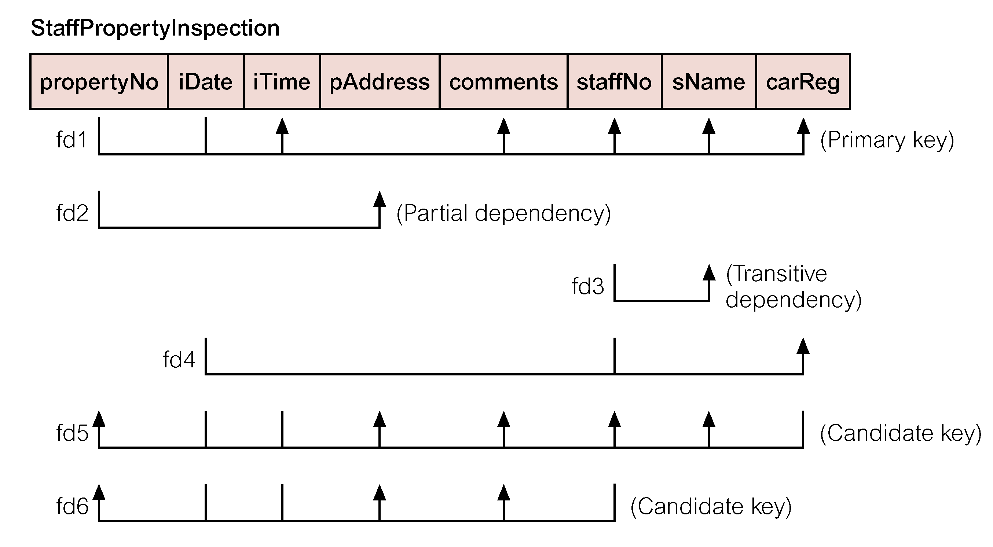
Review of Normalization (UNF to BCNF)

Slide 14
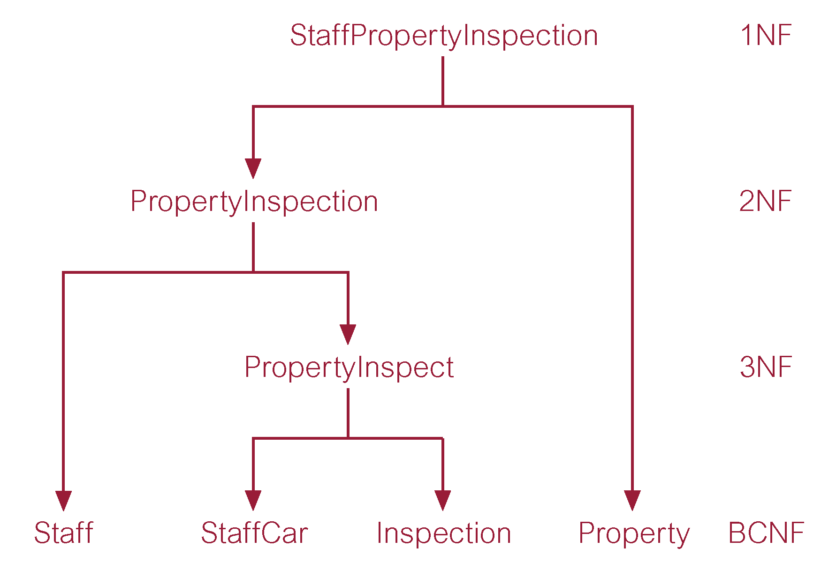
Review of Normalization (UNF to BCNF)

Slide 15
Fourth Normal Form (4NF)
Although BCNF removes anomalies due to functional dependencies, another type of dependency called a multi-valued dependency (MVD) can also cause data redundancy.
Possible existence of multi-valued dependencies in a relation is due to 1NF and can result in data redundancy.
Multi-valued Dependency (MVD)
Dependency between attributes (for example, A, B, and C) in a relation, such that for each value of A there is a set of values for B and a set of values for C. However, the set of values for B and C are independent of each other.

Slide 16
Fourth Normal Form (4NF)
MVD between attributes A, B, and C in a relation using the following notation:
A −>> B
A −>> C
A multi-valued dependency can be further defined as being trivial or nontrivial.
A MVD A −>> B in relation R is defined as being trivial if (a) B is a subset of A or (b) A U B = R.
A MVD is defined as being nontrivial if neither (a) nor (b) are satisfied.
A trivial MVD does not specify a constraint on a relation, while a nontrivial MVD does specify a constraint.
Defined as a relation that is in Boyce-Codd Normal Form and contains no nontrivial multi-valued dependencies.

Slide 17
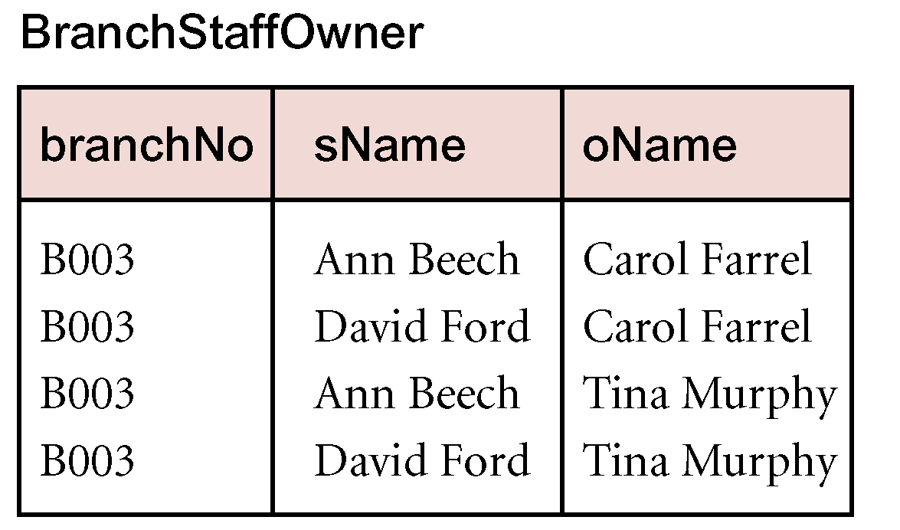
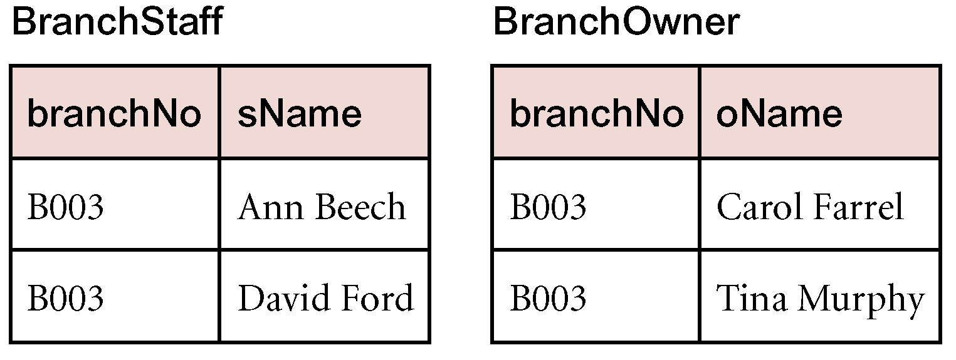
4NF - Example

Slide 18
Fifth Normal Form (5NF)
A relation decompose into two relations must have the lossless-join property, which ensures that no spurious tuples are generated when relations are reunited through a natural join operation.
However, there are requirements to decompose a relation into more than two relations. Although rare, these cases are managed by join dependency and fifth normal form (5NF).
Defined as a relation that has no join dependency.

Slide 19
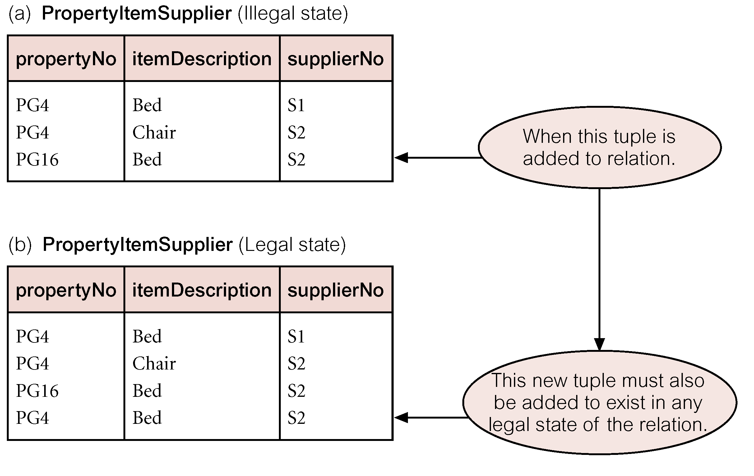
5NF - Example

Slide 20
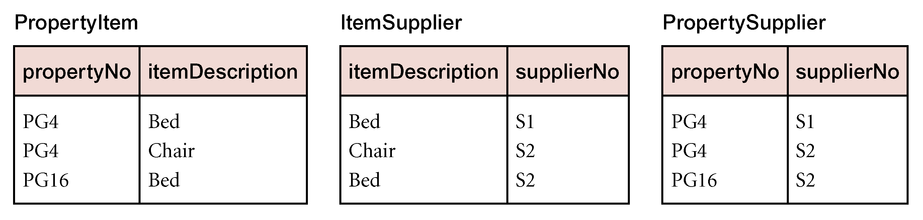
5NF - Example

